Slide 1
Brain Tumour Classification
Prateek Jain - 1BM18IS149
Akash Mishra - 1BM18IS006
Abhijit Kumar - 1BM18IS004

Slide 2
Problem Statement
In this project we try to provide diagnosis based on the input X-ray images of the brain. In our project we have demonstrated a specific use case of the powerful CNN architecture for diagnostic purposes on the brain-tumor dataset obtained from Kaggle.
Dataset - (Brian Tumor Dataset | Kaggle)

Slide 3
Dataset
The brain tumour dataset was obtained from Kaggle. The brain tumour dataset contains X-ray images of brain along with the caption/diagnosis. The dataset contains 139 image files containing the x-ray images. The .csv file contains 12 columns which are filename, diagnosis/class, colour-mode (RGB/L), file format(jpg/jpeg/tiff), shape of the image being the prominent features of the dataset .

Slide 4
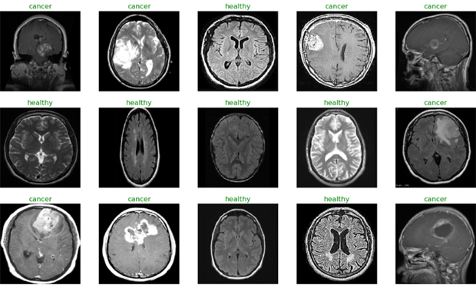

Slide 5
Pre-processing
Since our dataset has only 139 files, we can increase the number of images we have in the dataset by doing data augmentation.
Apart from data augmentation we have to pre-process the dataset as we do not have the required format of data. In the dataset we have to convert the images files into 2D vectors and since the files are in different folders we have to create a dataframe and shuffle them so that the model does not suffer from any unnatural pattern in the data created by us.

Slide 6
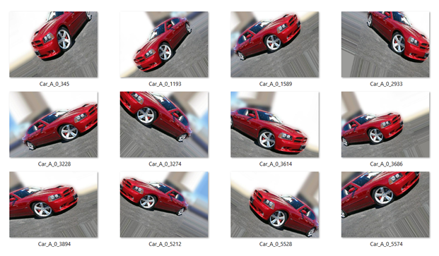

Slide 7
Model
We have used the sequential API offered by Keras to build the CNN architecture. The image is first fed into a convolution layer with 32 filters and the activation function used is relu and the output from this layer is passed to a max pooling layer as a result of this the spatial dimension of the image is reduced by half, after this the batch normalization is applied, we repeat this step again and finally we flatten the inputs by using a flatten layer and proceed by adding dense layers, since the model can be prone to overfitting we add a dropout layer to reduce overfitting.

Slide 8
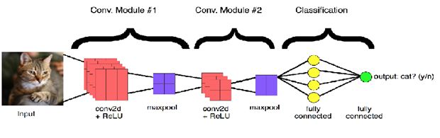

Slide 9
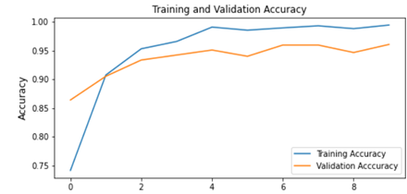
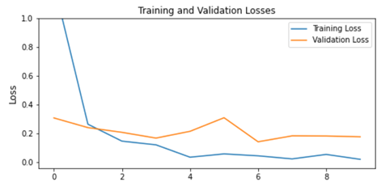
Results

Slide 10
